Slide 1
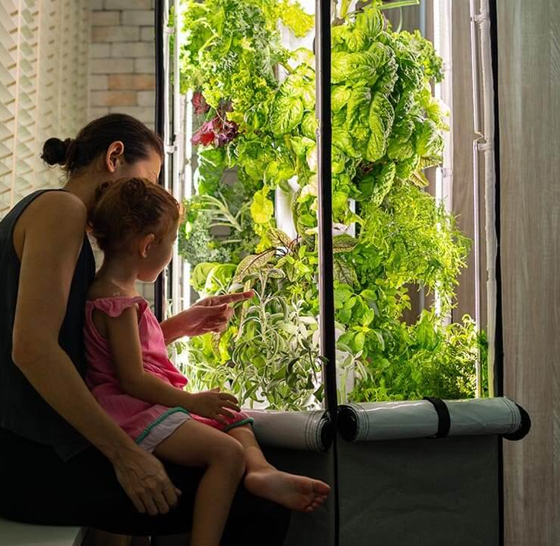
Hydroponics, Aeroponics, and Modern Horticulture Techniques
A few slides to get you thinking and growing.

Slide 2
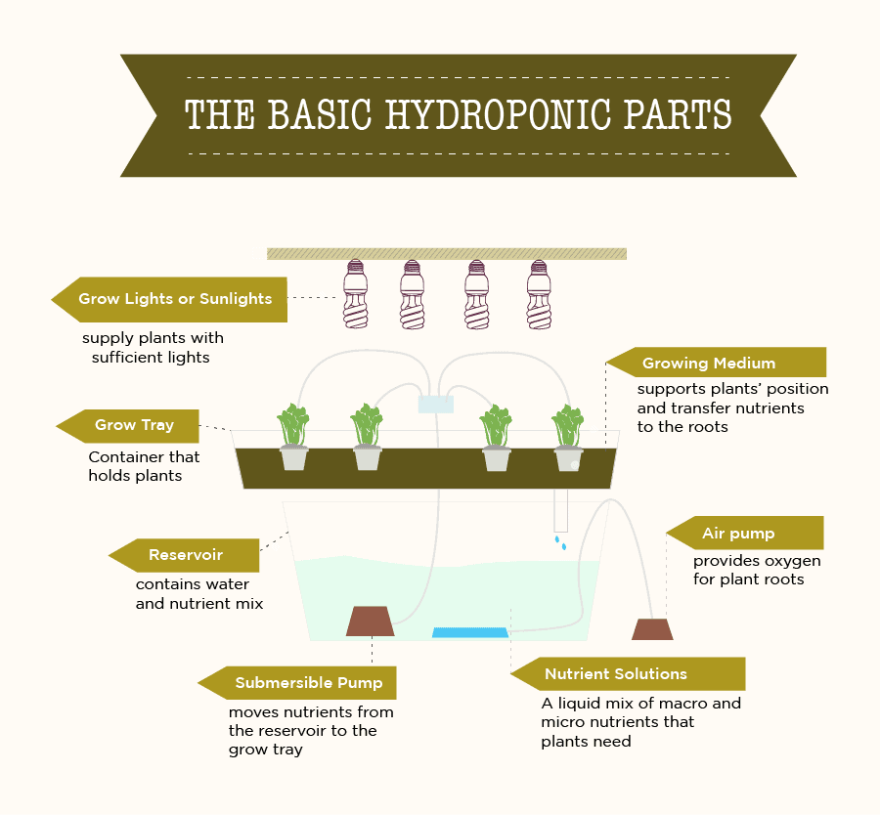
Basics of Hydroponics
The practice of growing plants in a nutrient-rich water solution, in lieu of traditional soil-based methods
Conceptually established in 1627 by Francis Bacon, proof-of-concept work done in 1699 by botanist John Woodward
Modern hydroponics as a research area and new technology established in 1929 at UC Berkley, by plant physiologist William Frederick Gericke

Slide 3
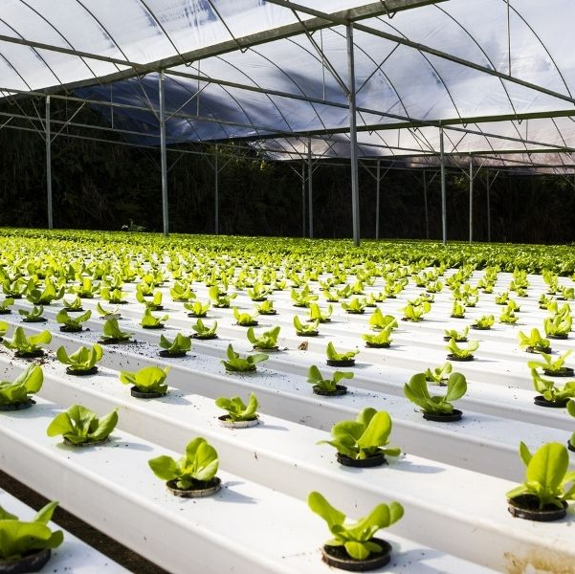
Benefits of Hydroponics
Climate Control
Uses less water than traditional agriculture in comparable amounts of space
Higher yields in comparable amounts of space
No need for pesticides or herbicides

Slide 4
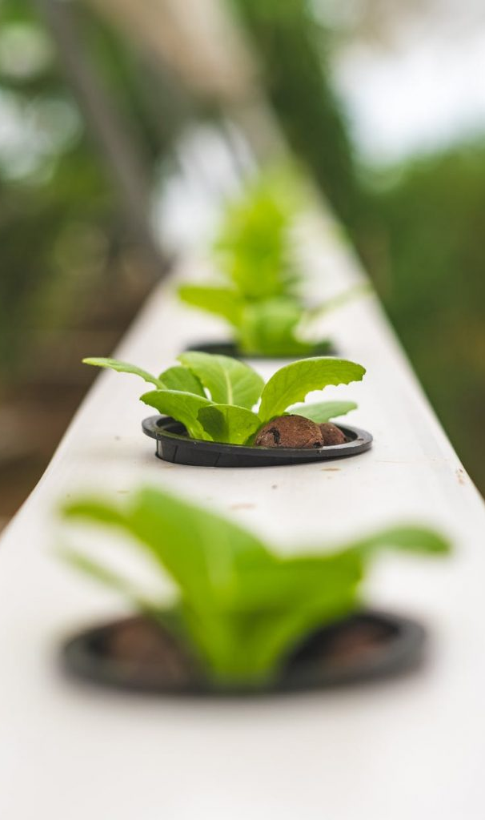
Some Downsides of Hydroponics
Higher initial cost than traditional gardening (equipment costs)
Requires electricity
Not ideal for growing staple crops (corn, soybeans, grains)
High maintenance
Bacteria and algae concerns

Slide 5
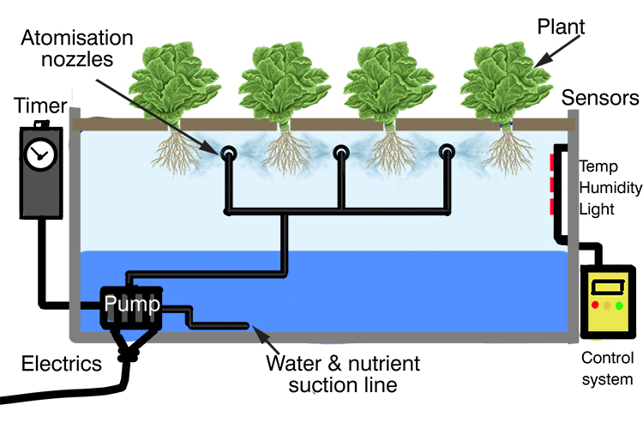
Aeroponics
Another method of soil-less growing
Many similar benefits to hydroponics
Even more water efficient than hydroponic systems
Entirely dependent on electricity
Faster growth and higher yields due to the high levels of oxygen the plant roots receive

Slide 6
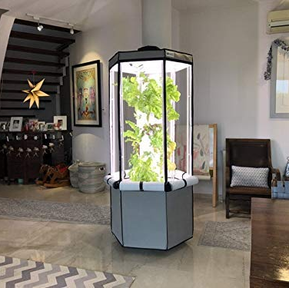
Aerospring Indoor System
Hybrid aero/hydro system
Water filled base (20 Gallons)
Holds up to 27 plants at once
Full-spectrum LED grow lights
Electric pump system to deliver water up the column
Water atomizes at the top and trickles down through the column, back into the basin

Slide 7
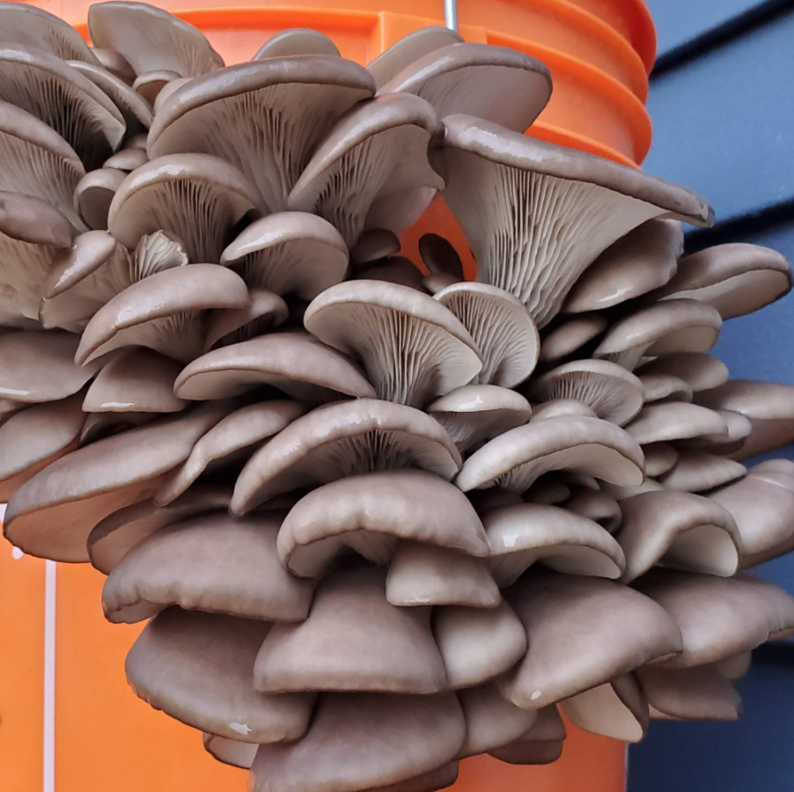
Other Alternative Growing Techniques
DIY Mycology
Urban/Guerilla Gardening
Seed Bombing
Re-wilding
Food Forests
Hugelkultur
Aquaponics

